Slide 1

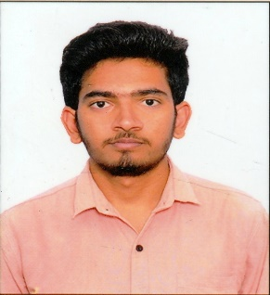
MANISH KUMAR S Analyst/Software Engineer India
Summary
Recent Experience
Represented the group of 5 members as group lead and led the group throughout the entire Capgemini training successfully.
Training Project
Description:
Cambridge Dictionary for Automation Testing which is related to getting meanings, learning grammar and getting translation.
Unacademy website for Manual Testing which is related to course trainings.
Responsibilities:
As a Tester, I was involved in
Involved in various phases of Software Testing Life Cycle(STLC) of the application like Test Scenario, Test Case, Test Execution, Defect Tracking, Execution Report.
Created a Template for User stories, scenarios and Test cases.
In Eclipse IDE automated the Test cases by using Selenium testing tool.
Worked on TestNG cucumber framework for BDD approach
Generated test results in the form of various reports.
A Hardworking and Highly Motivated Fresher with the skills of Manual Testing, Automation Testing, Core Java, Jira, TestNG, Cucumber, POM, Page Factory
Seeking an opportunity to obtain a position where I can utilize my technical and logical skills and to get a good outcome from a task which is assigned to me
Skills
Competencies
QA Automation : Selenium webdriver , BDD Cucumber.
Languages: Core Java
Tools: JIRA, Eclipse
Databases: SQL
Other: Manual Testing
Trainings/Certifications
Undergone training in Software Testing from QSpiders, Bangalore.
Completed training in SQL, Manual Testing, Core Java and Selenium from Capgemini.
I am certified on Get Started With JIRA, Agile Software Development and Automate an e-commerce web application using Selenium and java from Coursera.
Location: Mumbai, India
Years’ Experience: 3 months
Active Capgemini client industry experience:
V&V Automation Testing (Selenium+Java)

